Slide 1
MULTIPLEXING
FDM, TDM, STDM, WDM

Slide 2
Multiplexing
Under the simplest conditions, a medium can carry only one signal at any moment in time.
For multiple signals to share one medium, the medium must somehow be divided, giving each signal a portion of the total bandwidth.
The current techniques that can accomplish this include
Frequency Division Multiplexing (FDM)
Time Division Multiplexing (TDM)
Synchronous vs statistical
Wavelength Division Multiplexing (WDM)
Code Division Multiplexing (CDM)

Slide 3
Multiplexing
Multiplexing: The sharing of high capacity transmission medium between several transmissions.
  It is possible when the achievable data rate of the medium exceeds the data rate of digital signals to be transmitted.
Done using a multiplexor (Mux) made up of
  Multiplexor
    Device or mechanism
    Accepts data from multiple sources
    Sends data across shared channel
  Demultiplexor
    Device or mechanism
    Extracts data from shared channel
    Sends to correct destination

Slide 4
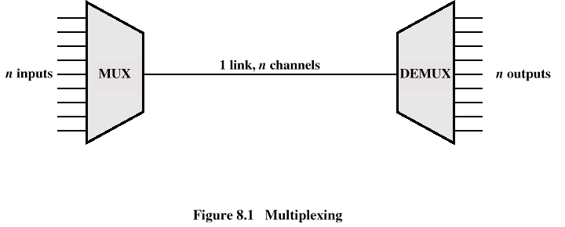
Multiplexing
Two or more simultaneous transmissions on a single circuit.
Multiplexing
Multiplexor (MUX)
Demultiplexor (DEMUX)
  Sometimes just called a MUX

Slide 5
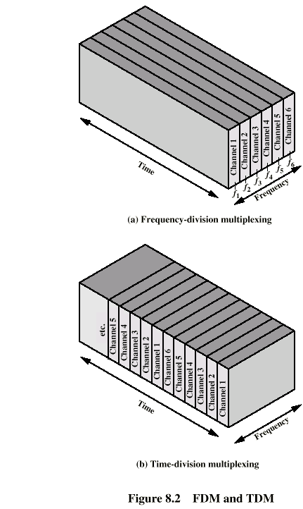
Frequency Division Multiplexing

Slide 6
Frequency Division Multiplexing
Frequency Division Multiplexing is assignment of non-overlapping frequency ranges to each “user” or signal on a medium. All signals are transmitted at the same time, each using different frequencies.
A multiplexor accepts inputs and assigns frequencies to each device.
The multiplexor is attached to a high-speed communications line.
A corresponding multiplexor, or demultiplexor, is on the end of the high-speed line and separates the multiplexed signals.

Slide 7
Frequency Division Multiplexing
It can only be used on analog facilities.
A number of low BW analog signals simultaneously transmitted on high BW link
Each signal is “shifted” in frequency by modulating a carrier signal
Shifted signals can be sent simultaneously since they do not overlap in frequency
  Have guard bands
Channel allocated even if no data
At receiver, filters separate “shifted” signals; demodulation recovers signals
Broadcast radio and television, cable television, and the AMPS cellular phone systems use frequency division multiplexing.

Slide 8
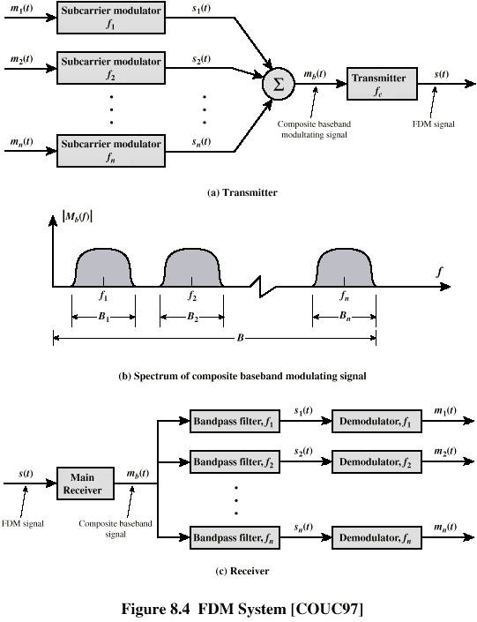
FDM

Slide 9

FDM MULTIPLEXING

Slide 10

FDM DEMULTIPLEXING

Slide 11

FREQUENCY MODULATION IS AN EXAMPLE OF FDM

Slide 12
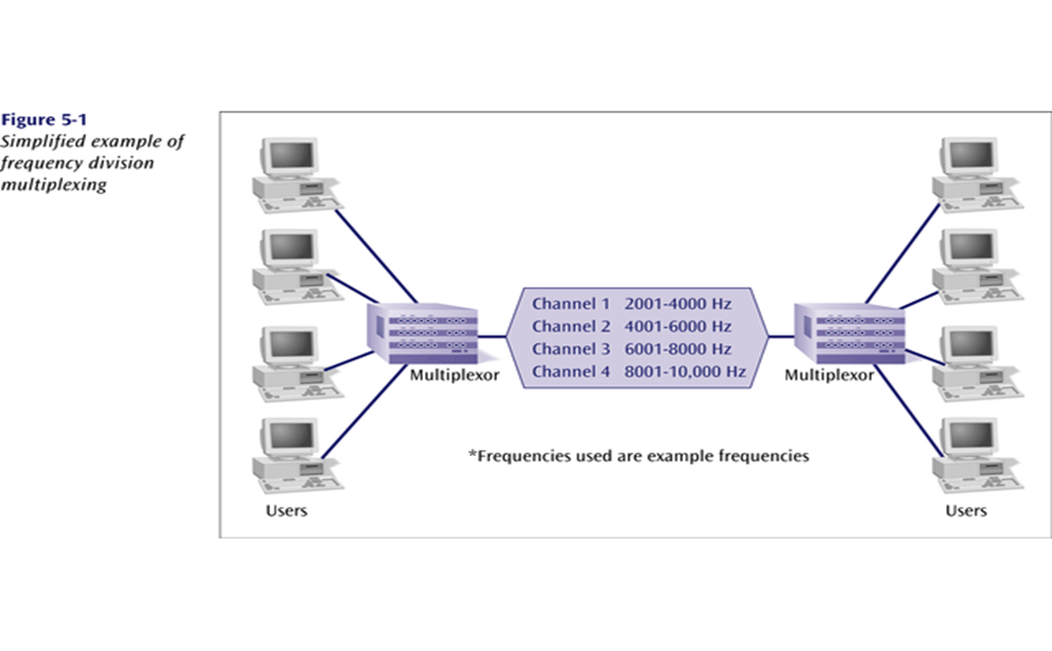
FDM

Slide 13
FDM
Example 1
Assume that a voice channel occupies a bandwidth of 4 kHz. We need to combine three voice channels into a link with a bandwidth of 12 kHz, from 20 to 32 kHz. Show the configuration, using the frequency domain. Assume there are no guard bands.
Solution
We shift (modulate) each of the three voice channels to a different bandwidth, as shown in Figure 6.6. We use the 20- to 24-kHz bandwidth for the first channel, the 24- to 28-kHz bandwidth for the second channel, and the 28- to 32-kHz bandwidth for the third one. Then we combine them as shown in Figure 1

Slide 14

FIGURE 1- FDM PROCESS

Slide 15
Example 2
Five channels, each with a 100-kHz bandwidth, are to be multiplexed together. What is the minimum bandwidth of the link if there is a need for a guard band of 10 kHz between the channels to prevent interference?
Solution
For five channels, we need at least four guard bands. This means that the required bandwidth is at least
5 × 100 + 4 × 10 = 540 kHz,
as shown in Figure 2.

Slide 16
FIGURE 2

Slide 17
FDM Transmission Schemes
Baseband transmission
  Uses only low frequencies
  Encodes data directly
Broadband transmission
  Uses multiple carriers
  Can use higher frequencies
  Achieves higher throughput
  Hardware more complex and expensive

Slide 18
Analogue Carrier Systems
Designed to transmit voice band signals over high capacity transmission links, based on FDM
A standardized FDM hierarchy
No of voice channels | Bandwidth | Spectrum | ITU-T
12 60 300 3600 | 48 kHz 240 kHz 2.52 MHz 16.984 MHz | 60 – 108 kHz 312 – 552 kHz 564 – 3084 kHz 0.564 – 17.548 MHz | Group Supergroup Mastergroup Supermaster group

Slide 19
Analogue Carrier Hierarchy

Slide 20
Analogue Carrier Systems

Slide 21
Analogue Carrier Systems
Problems of FDM
Crosstalk- occurs if the spectra of adjacent component signals overlap
Intermodulation noise- on a long link, the non-linear effects of amplifiers on a signal in one channel could produce frequency components in other channels

Slide 22
Time Division Multiplexing
Sharing of the signal is accomplished by dividing available transmission time on a medium among users.
Digital signaling is used exclusively.
Time division multiplexing comes in two basic forms:
  1. Synchronous time division multiplexing, and
  2. Statistical, or asynchronous time division multiplexing.

Slide 23
TDM

Slide 24
Synchronous TDM
High data rate of digital transmission medium used to simultaneously transmit a number of lower data rate digital signals
Sources are scanned in round-robin fashion; each source has fixed slot for transmission
At destination, the received stream is distributed to the corresponding receivers
Example: If a channel has a maximum capacity of 64 Kbps, it can be used to carry six sources of 9.6 Kbps. This gives a total of 57.6 Kbps, which is still below the maximum capacity of 64 Kbps.

Slide 25
Synchronous Time Division Multiplexing
If one device generates data at a faster rate than other devices, then the multiplexor must either sample the incoming data stream from that device more often than it samples the other devices, or buffer the faster incoming stream.
If a device has nothing to transmit, the multiplexor must still insert a piece of data from that device into the multiplexed stream.

Slide 26
Synchronous TDM

Slide 27
Interleaving
The process of taking a group of bits from each input line for multiplexing is called interleaving.
We interleave bits (1 - n) from each input onto one output.

Slide 28
Interleaving

Slide 29
Time Division Multiplexing
Buffer: Each is one bit or one character in length.
Scan Operation: The buffers are scanned sequentially to form a composite digital data stream.
  This operation is sufficiently rapid so that each buffer is emptied before more data can arrive.
  The transmitting multiplexer assigns consecutive time slots to the data that is to be transmitted and polls each device in turn until the entire character or message has been sent.
  The slot length equals the transmitter buffer length.

Slide 30
Time Division Multiplexing

Slide 31
TDM example 1
Example 1
Four channels are multiplexed using TDM. If each channel sends 100 bytes /s and we multiplex 1 byte per channel, show the frame traveling on the link, the size of the frame, the duration of a frame, the frame rate, and the bit rate for the link.
Solution
The multiplexer is shown in Figure 6.16. Each frame carries 1 byte from each channel; the size of each frame, therefore, is 4 bytes, or 32 bits. Because each channel is sending 100 bytes/s and a frame carries 1 byte from each channel, the frame rate must be 100 frames per second. The bit rate is 100 × 32, or 3200 bps.

Slide 32

TDM example

Slide 33
TDM example 2
A multiplexer combines four 100-kbps channels using a time slot of 2 bits. Show the output with four arbitrary inputs. What is the frame rate? What is the frame duration? What is the bit rate? What is the bit duration?
Solution
Figure 6.17 shows the output (4x100kbps) for four arbitrary inputs. The link carries 400K/(2x4)=50,000 2x4=8bit frames per second. The frame duration is therefore 1/50,000 s or 20 μs. The bit duration on the output link is 1/400,000 s, or 2.5 μs.

Slide 34

TDM example 2

Slide 35
Digital Carrier Systems
Hierarchy of TDM
USA/Canada/Japan use one system
ITU-T use a similar (but different) system
US system based on DS-1 format
Multiplexes 24 channels
Each frame has 8 bits per channel plus one framing bit
193 bits per frame

Slide 36
Digital Carrier Systems
For voice each channel contains one word of digitized data (PCM, 8000 samples per sec)
  Data rate 8000x193 = 1.544Mbps
  Five out of six frames have 8 bit PCM samples
  Sixth frame is 7 bit PCM word plus signaling bit
  Signaling bits form stream for each channel containing control and routing info
Same format for digital data
  23 channels of data
    7 bits per frame plus indicator bit for data or systems control
  24th channel is sync

Slide 37
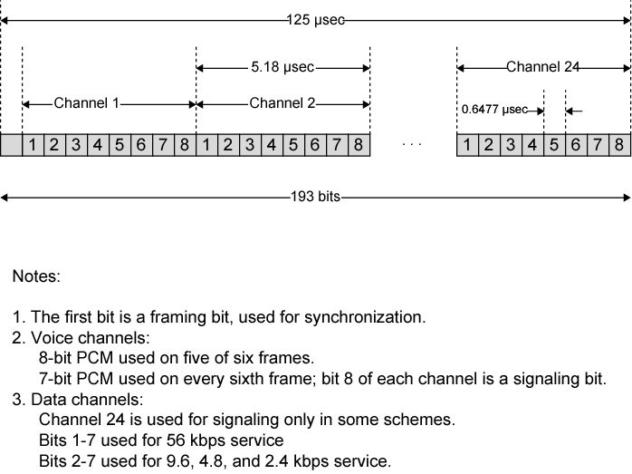
DS-1

Slide 38
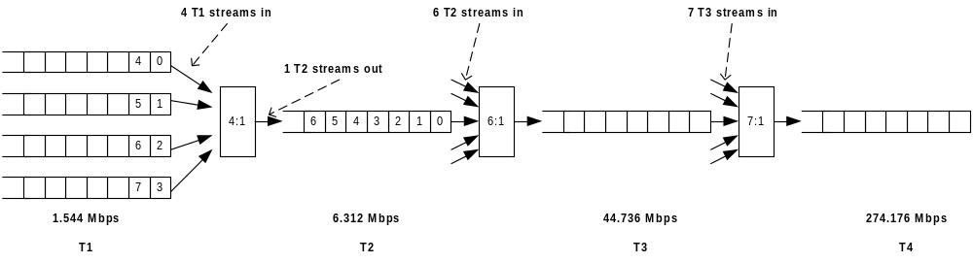
TDM T carrier standards
North American |  |  |  | International
Carrier system | Frame format | Number of voice channels | Data rate (Mbps) | Level number | Number of voice channels | Data rate (Mbps)
T-1 T-1C T-2 T-3 T-4 | DS-1 DS-1C DS-2 DS-3 DS-4 | 24 48 96 672 4032 | 1.544 3.152 6.312 44.736 274.176 | 1 2 3 4 5 | 30 120 480 1920 7680 | 2.048 8.448 34.368 139.264 565.148

Slide 39

Digital hierarchy

Slide 40
E1 CARRIER SYSTEMS
The most commonly used digital capacity is E1
This is a digital transmission capacity whose bandwidth is equivalent to 2048Kb/s
Derivation of E1 capacity
Voice signals have the highest concentration of intelligence between 0.3 – 3.4 KHz.
This is approximately 0 - 4 KHz

Slide 41
E1 CARRIER SYSTEMS
In an E1, there are 32 channels and each channel is sampled at 8000Hz.
There are 8 bits per channel
Capacity for one channel =8000Hz x 8 = 64000bits/sec
Thus total capacity for 32 channels = 32x64000bits/sec = 2048000bits/sec.
Thus digital capacity for E1 system = 2048Kbits/sec or 2.048Mbps
The 32 channels in an E1 are numbered from 0 to 31.

Slide 42
E1 system
Channel 0 carries synchronization information or frame alignment and channel 16 carries signaling information.
The rest of the channels can carry data or voice data. Total data or voice carried by the E1 channel is called Payload.
0 | 1 | 2 | 3 | 4 | 5 | 6 | 7 | 8 | 9 | 10 | 11 | 12 | 13 | 14 | 15 | 16 | 17 | 18 | 19 | 20 | 21 | 22 | 23 | 24 | 25 | 26 | 27 | 28 | 29 | 30 | 31

Slide 43
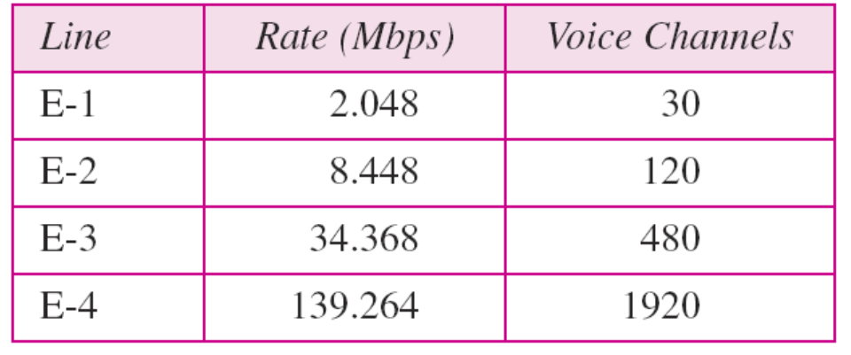
E1 CARRIER SYSTEMS

Slide 44
Statistical TDM
With synchronous TDM, channel capacity was wasted when sources transmit intermittently (Due to fixed assignment of channel)
In STDM, a statistical multiplexor accepts the incoming data streams and creates a frame containing only the data to be transmitted
Statistical TDM (also known as asynchronous TDM and intelligent TDM) does not use fixed assignment; a source gets a time slice only if it is active.
It works on the principle that the average data rate is less than the nominal or maximum rate.
It takes advantage of the fact that the attached devices are not all transmitting at the same time.
With the Statistical Mux, the positional significance of the slots is lost.
    It can not be known ahead of time, which source’s data will be in any particular slot.
    Address information is required to assure proper delivery - adds an extra overhead per slot.

Slide 45
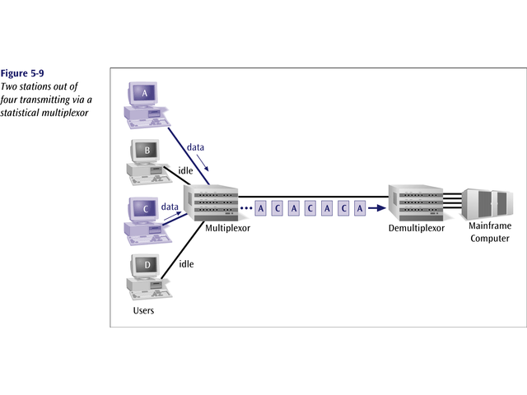
Statistical TDM

Slide 46
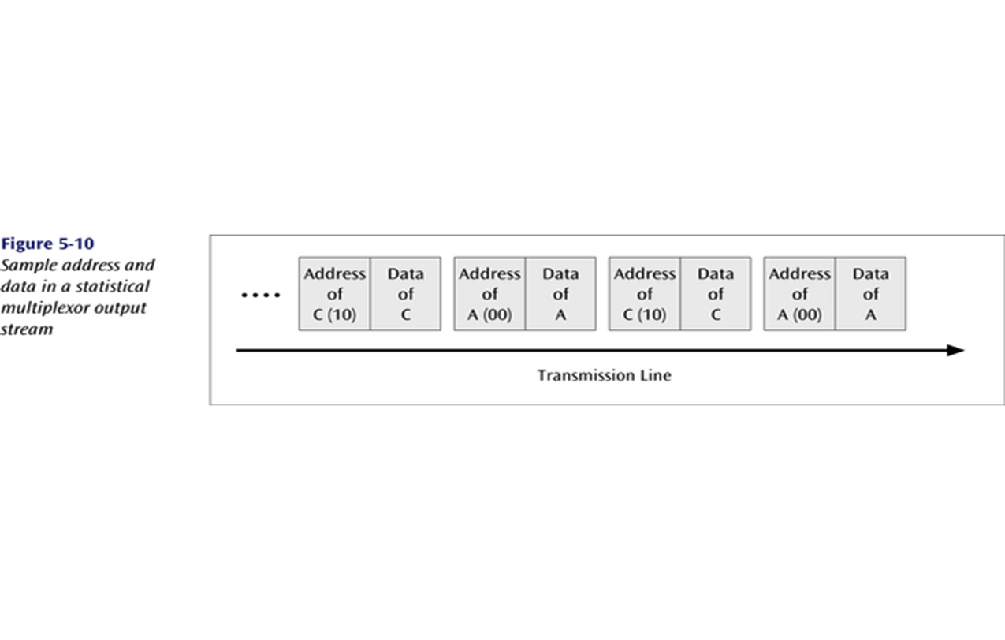
Statistical TDM
To identify each piece of data, an address is included.

Slide 47
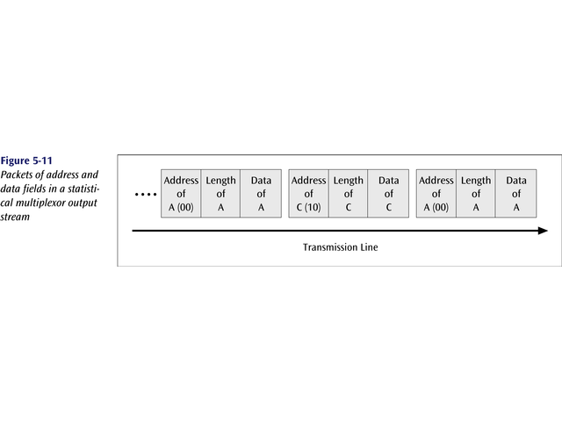
Statistical TDM
If the data is of variable size, a length is also included.

Slide 48
Statistical TDM
A statistical multiplexor does not require high speed line as synchronous time division multiplexing since STDM does not assume all sources will transmit all of the time!
Good for low bandwidth lines (used for LANs)
Much more efficient use of bandwidth!

Slide 49
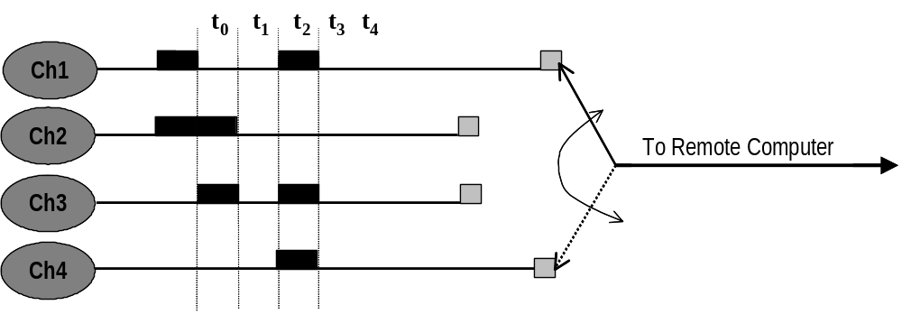
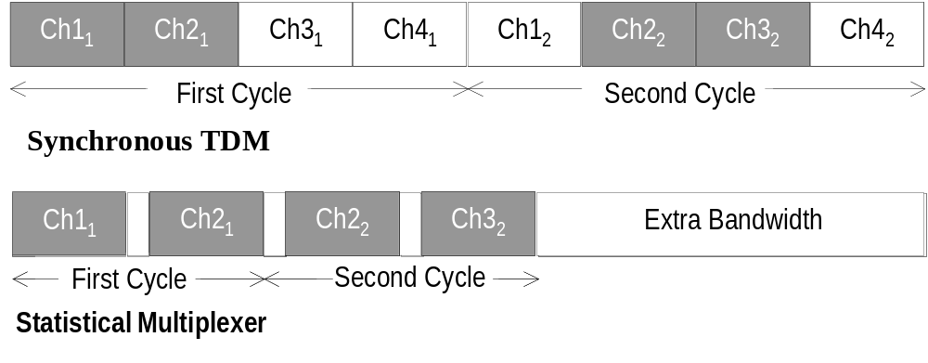
Statistical TDM (StatMux)

Slide 50
Wavelength Division Multiplexing (WDM) - Overview
Wavelength Division Multiplexing (WDM)
Give each message a different wavelength (frequency)
Easy to do with fiber optics and optical sources

Slide 51

Wavelength Division Multiplexing (WDM)

Slide 52
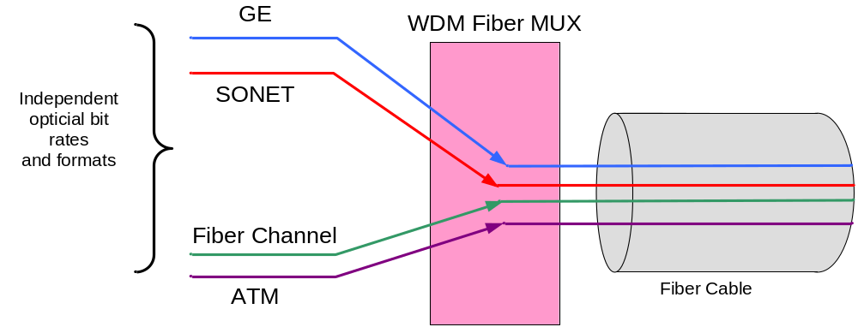
Wavelength Division Multiplexing (WDM)
Wave Division Mutiplexing (WDM) multiplexes multiple optical carrier signals on a single optical fiber by using different wavelengths (colors) of laser light to carry different signals.
  Bit rate and protocol independent

Slide 53
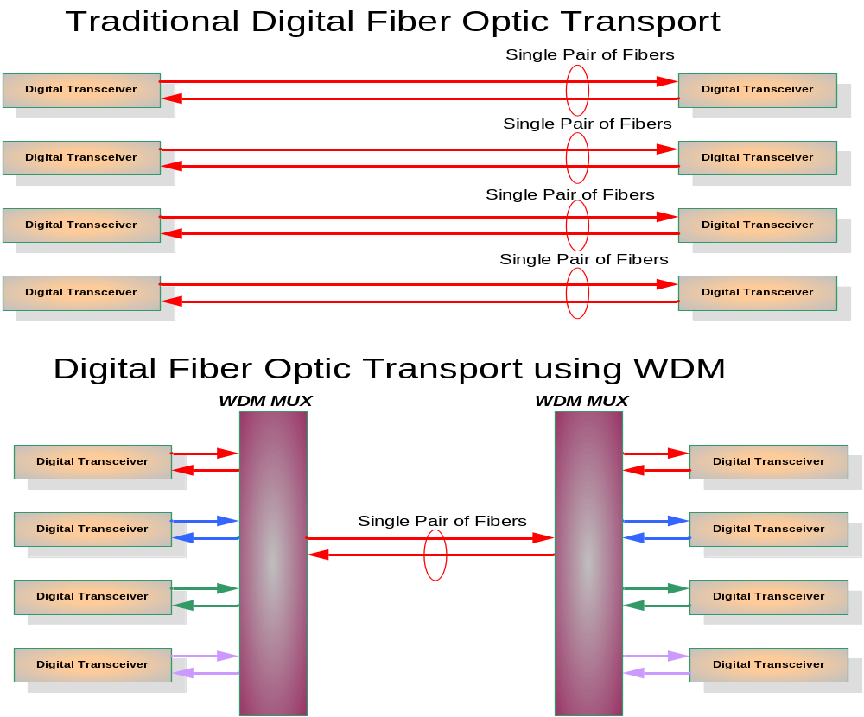
Overview

Slide 54
Overview
Two main types of WDM:
  Coarse Wavelength Division Multiplexing (CWDM)- wider channel spacing
  Dense Wavelength Division Multiplexing (DWDM)
Feature | CWDM | DWDM
Wavelengths per fiber | 8 – 16 | 40 – 80
Wavelength spacing | 2500GHz (20nm) | 100 GHz (0.8nm)
Wavelength capacity | Up to 2.5 Gbps | Up to 10 Gbps
Aggregate fiber capacity | 20 – 40 Gbps | 100 – 1000 Gbps
Overall cost | Low | Medium
Applications | Enterprise, metro-access | Access, metro-core, regional

Slide 55
Dense Wavelength Division Multiplexing
Dense wavelength division multiplexing is often called just wavelength division multiplexing
Dense wavelength division multiplexing multiplexes multiple data streams onto a single fiber optic line.
Different wavelength lasers (called lambdas) transmit the multiple signals.
Each signal carried on the fiber can be transmitted at a different rate from the other signals.
Dense wavelength division multiplexing combines many (30, 40, 50, 60, more?) onto one fiber.

Slide 56
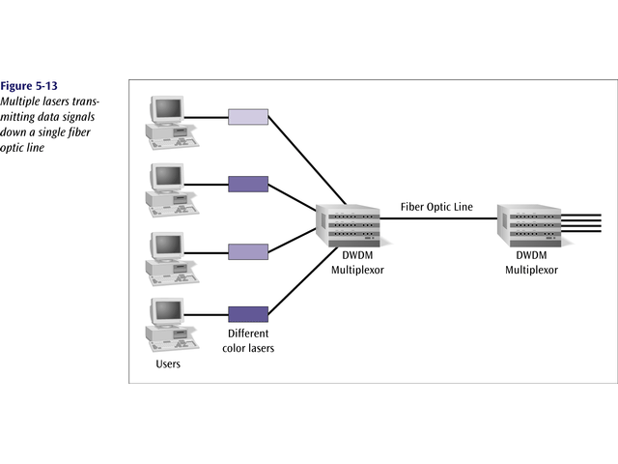
Dense Wavelength Division Multiplexing

Slide 57
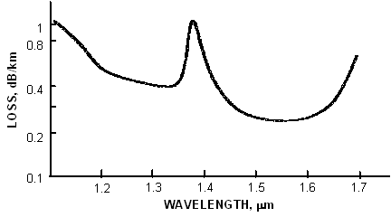
Overview
Fiber Characteristics
C Band Range : 1530nm – 1560nm
L Band Range : 1570nm – 1600nm
Water Peak
1550
Window
1310
Window

Slide 58
Overview- WDM Components
λ1
850/1310
15xx
λ2
λ1...n
λ3
Transponder
Optical Multiplexer
λ1
λ1...n
λ1
λ2
λ2
λ3
λ3
Optical De-multiplexer
Optical Add/Drop Multiplexer
(OADM)

Slide 59
CODE DIVISION MULTIPLEXING
Code Division Multiplexing (CDM)
  Old method there is a new method
Also known as code division multiple access (CDMA)
CDMA is a wireless communications technology that uses the principle of spread spectrum communication.
CDMA is an advanced technique that allows multiple devices to transmit on the same frequencies at the same time using different codes
Used for mobile communications

Slide 60
CODE DIVISION MULTIPLEXING
In code division multiple access each mobile device is assigned a unique 64-bit code (chip spreading code)
To send a binary 1, mobile device transmits the unique code
To send a binary 0, mobile device transmits the inverse of code
Receiver gets summed signal, multiplies it by receiver code, adds up the resulting values
Interprets as a binary 1 if sum is near +64
Interprets as a binary 0 if sum is near –64

Slide 61
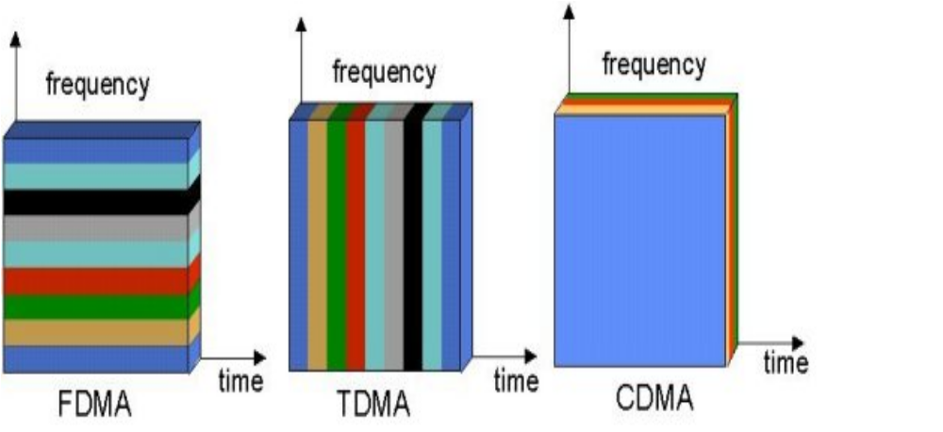
FDMA, TDMA, CDMA

Slide 62
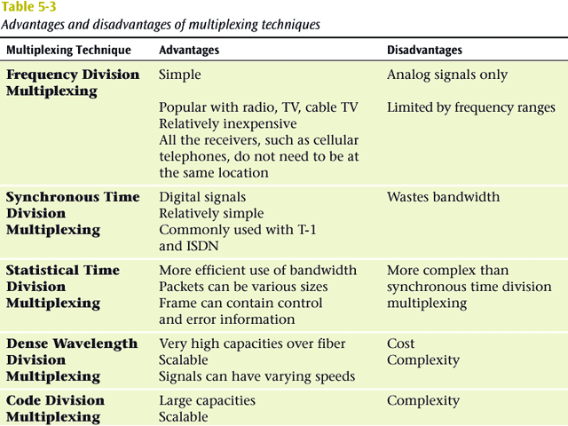
COMPARISON OF MULTIPLEXING TECHNIQUES

Slide 63
Dedicated Circuit Services
Dedicated circuits involve leasing circuits from common carriers to create point to point links between organizational locations.
These points are then connected together using special equipment such as routers and switches.
Dedicated circuits are billed at a flat fee per month for which the user has unlimited use of the circuit.
Dedicated circuits therefore require more care in network design than dialed circuits.
The three basic dedicated circuit architectures are ring, star, and mesh architectures.

Slide 64
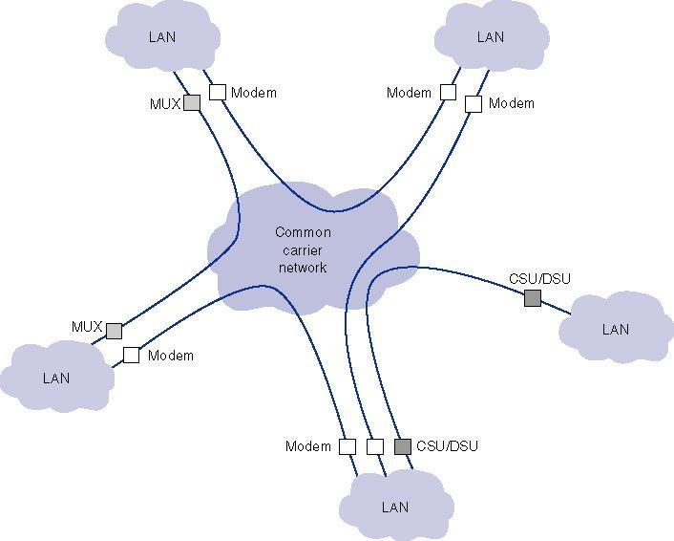
Dedicated Circuit Services

Slide 65
T-Carriers
Broadband
  Group of network connection types or transmission technologies generally capable of exceeding 1.544 Mbps throughput
T-carriers
  Term for any kind of leased line that follows the standards for T1s, fractional T1s, T1Cs, T2s, T3s, or T4s
Signal level
  ANSI standard for T-carrier technology that refers to its Physical layer electrical signaling characteristics
The basic unit of the T-hierarchy is the 64 Kbps DS-0 (Digital Signal-level 0) created by digitizing an analog voice channel using Pulse Code Modulation.

Slide 66
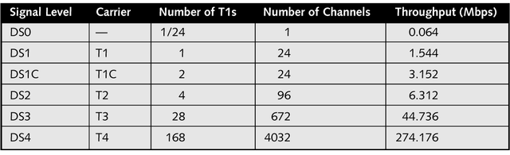
Types of T-Carrier Services
T-Carrier circuits include:
  T-1 circuit (a.k.a. DS-1) has a data rate of 1.544 Mbps. T-1’s allow 24 simultaneous 64 Kbps channels which transport data or voice messages using PCM.
  T-2 (6.312 Mbps) multiplexes four T-1 circuits.
  T-3 (44.376 Mbps) has a 28 T-1 capacity.
  T-4 (274.176 Mbps) has a 178 T-1 capacity.
  Fractional T-1, (FT-1) offers a portion of a T-1.

Slide 67
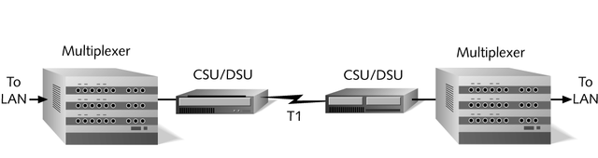
T-Carrier Connectivity
Wiring
  Can use unshielded or shielded twisted-pair copper wiring
CSU/DSU (Channel Service Unit/Data Service Unit)
  CSU provides termination for the digital signal and ensures connection integrity through error correction and line monitoring
  DSU converts the digital signal used by bridges, routers, and multiplexers into the digital signal sent via the cabling

Slide 68
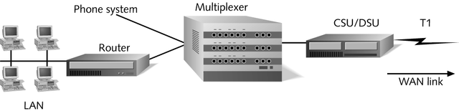
T-Carrier Connectivity
Multiplexer
  Device that combines multiple voice or data channels on one line

Slide 69
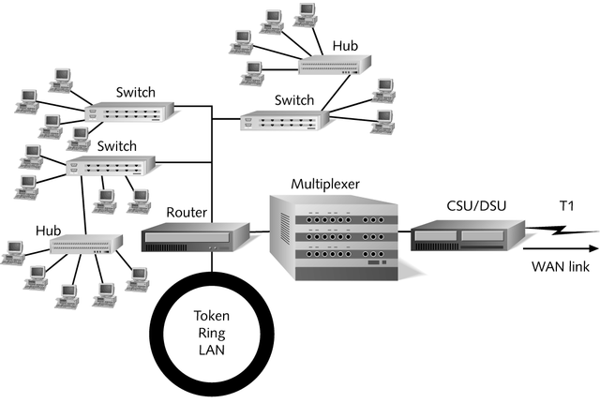
T-Carrier Connectivity
Routers and bridges
  On a typical T1-connected data network, terminal equipment will consist of bridges, routers or a combination of the two

Slide 70
DSL
Digital Subscriber Lines
Uses advanced data modulation techniques to achieve extraordinary throughput over regular phone lines
Like ISDN, DSL can span only limited distances without the help of repeaters

Slide 71
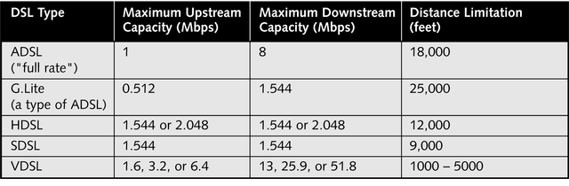
Types of DSL
Term xDSL refers to all DSL varieties, of which at least eight currently exist
DSL types can be divided into two categories:
  Asymmetrical- Higher data rates for downstream
  Symmetrical – Same data rates for up/downstream

Slide 72
Asymmetrical Digital Subscriber Line
ADSL
Link between subscriber and network
  Local loop
Uses currently installed twisted pair cable
  Can carry broader spectrum
  1 MHz or more

Slide 73
ADSL Design
Asymmetric DSL
  Greater capacity downstream than upstream
Frequency division multiplexing
  Lowest 25kHz for voice
    Plain old telephone service (POTS)
  Use echo cancellation or FDM to give two bands
  Use FDM within bands
Range 5.5km

Slide 74
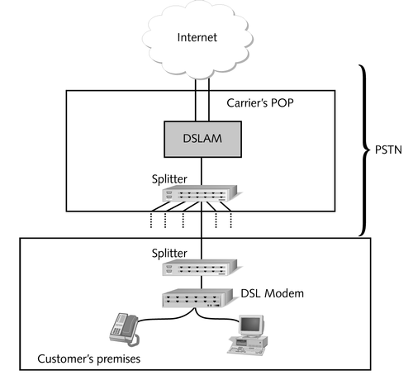
DSL Connectivity
DSL connectivity, like ISDN, depends on the PSTN
Inside carrier’s POP, a device called a DSL access multiplexer (DSLAM) aggregates multiple DSL subscriber lines and connects them to a larger carrier or to the Internet backbone

Slide 75
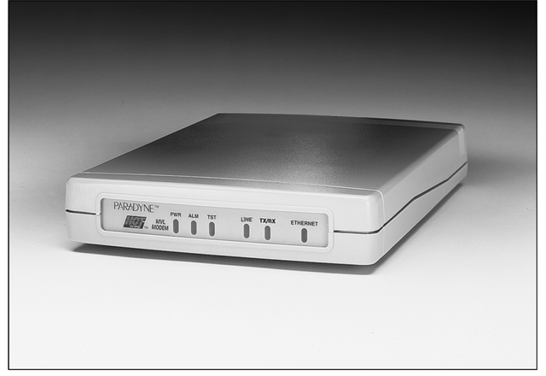
DSL Connectivity
Once inside the customer’s home or office, the DSL line must pass through a DSL modem

